Slide 1
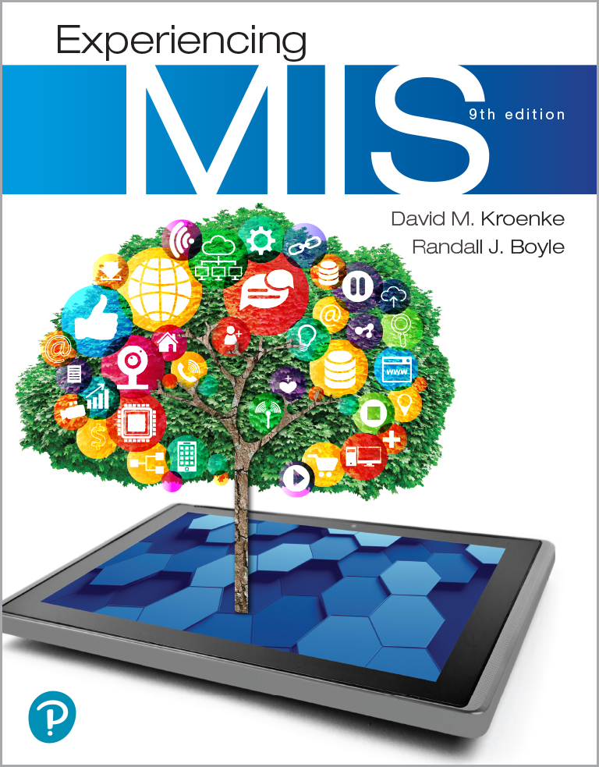
Experiencing M I S
Ninth Edition
Chapter 4
Hardware and Software
Slides in this presentation contain hyperlinks. JAWS users should be able to get a list of links by using INSERT+F7
Copyright © 2021, 2019, 2017 Pearson Education, Inc. All Rights Reserved
Notes:
If this PowerPoint presentation contains mathematical equations, you may need to check that your computer has the following installed:
1) MathType Plugin
2) Math Player (free versions available)
3) NVDA Reader (free versions available)
This chapter discusses hardware, software, and open source alternatives, and defines basic terms and fundamental computing concepts. It briefly touches on new developments in self-driving cars, 3D printing, and the Internet of Things. Plus, it looks at the importance of opensource software as a viable alternative.

Slide 2
“How is the AI project going?”
eHermes investigating using AI to improve operational efficiency
Cut costs by 20% and double efficiency
Going much more slowly than anticipated
Employee expertise is self-driving vehicles, not AI
Not enough data to train the AI
Data patterns constantly shifting
Need to hire team of AI experts
Frustrating being on the “bleeding edge”
Notes:
GOALS
Show a realistic outcome for the team’s investigation: eHermes is not an AI company.
Demonstrate the innovative application of new 3D printing technology.
Chapter 3 discussed the processes and systems Falcon would have to build if it started manufacturing its own drones. What were some of those processes and systems they would have to build?

Slide 3
Study Questions
4-1 What do business professionals need to know about computer hardware?
4-2 How can new hardware affect competitive strategies?
4-3 What do business professionals need to know about software?
4-4 Is open source software a viable alternative?

Slide 4
Processors and Memory
4-1 What do business professionals need to know about computer hardware?
Central processing unit (C P U)—“the brain.”
Dual-processor and Quad-processor computers.
C P U s vary in speed, function, cost.
C P U works in conjunction with main memory (R A M).
C P U reads data and instructions from memory, and stores results of computation in memory.
Notes:
For a more detailed discussion of CPU architecture, refer them to https://www.pctechguide.com/cpu-architecture.

Slide 5
Storage Hardware
4-1 What do business professionals need to know about computer hardware?
Save data and programs
Common storage devices
Non-volatile
Magnetic disks (Hard drive)
Solid-state storage (S S D)
USB flash drives
Optical disks (C D/D V D)
Volatile—cache and main memory

Slide 6
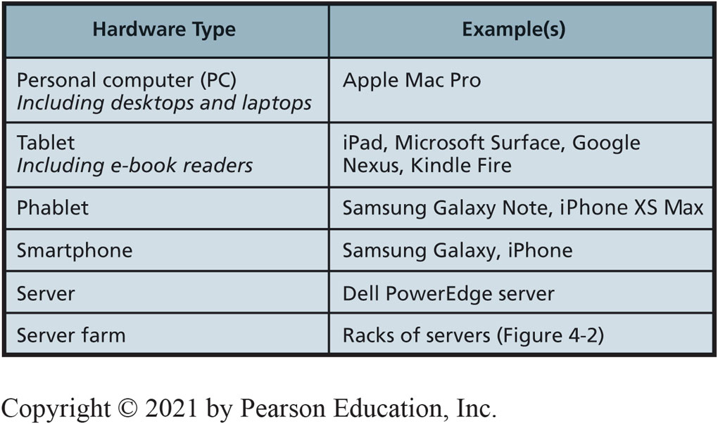
Basic Types of Hardware
4-1 What do business professionals need to know about computer hardware?
Figure 4-1 Basic Types of Hardware

Slide 7
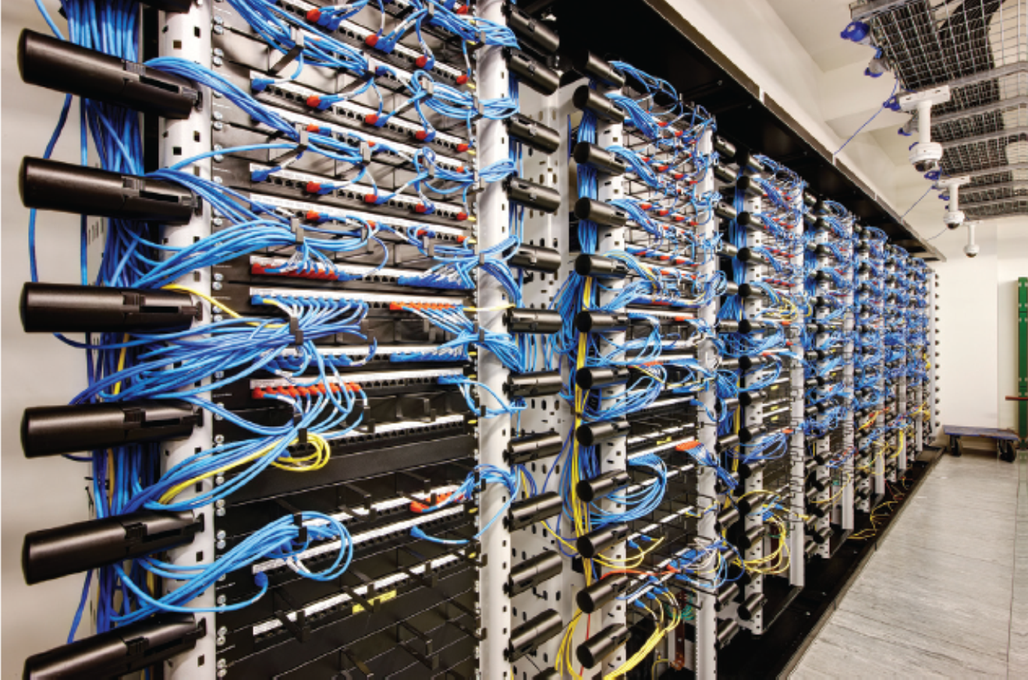
Server Farm
4-1 What do business professionals need to know about computer hardware?
Figure 4-2 Server Farm
Source: © Andrew Twort/Alamy
Notes:
Large server farms by Microsoft, Google, and others cost $1B+ to build, and employ about a total of 50 people to operate.

Slide 8
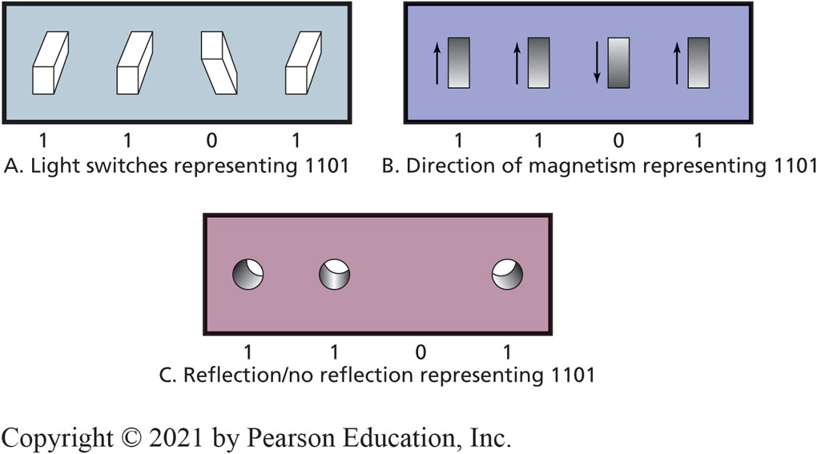
Computer Data: Binary Digits (Bits)
4-1 What do business professionals need to know about computer hardware?
Figure 4-3 Bits Are Easy to Represent Physically
Notes:
Bits are used for computer data because they are easy to represent electronically.
Bits are used to represent electronically. A switch can be open or closed.
An open switch represents 0 or “off” and a closed switch represents “1” or “on”.

Slide 9
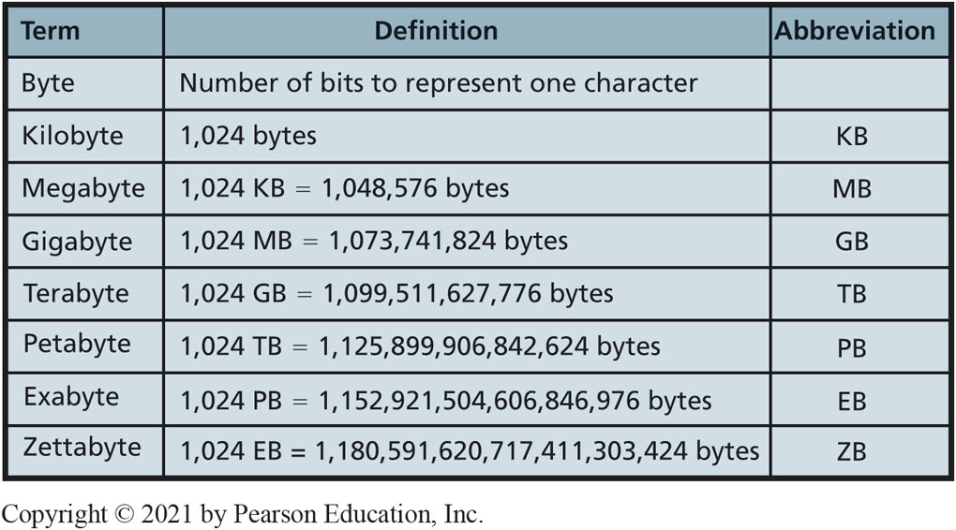
Important Storage Capacity Terminology
4-1 What do business professionals need to know about computer hardware?
Figure 4-4 Important Storage-Capacity Terminology
Notes:
All computer data are represented by bits. Data can be numbers, characters, currency amounts, photos, recordings, or whatever. All are simply a string of bits. Specifications for size of main memory, disk, and other computer devices are expressed in bytes.

Slide 10
Specifying Hardware with Computer Data Sizes
4-1 What do business professionals need to know about computer hardware?
Disk capacities specified by amount of bytes.
500 GigaByte
C P U speed expressed in cycles called hertz.
Slow personal computer speed of 3.0 Gigahertz.
Fast P C 3.5+ GigaHertz.
Notes:
For more information, see https://www.wisegeek.com/how-much-laptop-memory-do-i-need.htm.

Slide 11
Disruptive New Tech Hardware
4-2 How can new hardware affect competitive strategies?
Potentially disruptive hardware developments for existing organizations.
Internet of Things (I o T)
Digital Reality Devices
Self-Driving Cars
3D Printing
Cryptocurrencies
Notes:
Explain categories of computer software.

Slide 12
Internet of Things (I o T)
4-2 How can new hardware affect competitive strategies?
Everyday objects embedded with hardware capable of sensing, processing, transmitting data.
Objects share data via a network with any other application, service, or device.
Figure 4-5 Smartphone Development
Source: Grgroup/Fotolia
Notes:
The network could be a communication company, company network, or the Internet.

Slide 13
Impact of the Internet of Things
4-2 How can new hardware affect competitive strategies?
G E’s Industrial Internet
Increase efficiencies, reduce waste, improve decision making.
Greatest potential for smart devices in hospitals, power grids, manufacturing plants, and transportation.
Smart buildings (Microsoft)
I D problems like wasteful lighting, competing heating and cooling systems, rogue fans, etc.

Slide 14
Digital Reality Devices (1 of 3)
4-2 How can new hardware affect competitive strategies?
Tremendous potential to revolutionize our daily lives.
Will create entirely new types of companies.
Change the way people live, work, shop, and entertain themselves.
Different levels of digital reality on a continuum from completely real environments to completely virtual environments.

Slide 15
Digital Reality Devices (2 of 3)
4-2 How can new hardware affect competitive strategies?
Augmented reality (A R) is the altering of reality by overlaying digital information on real-world objects.
Mixed reality (M R) is the combination of the real physical world with interactive virtual images or objects.
Virtual reality (V R), or a completely computer-generated virtual world with interactive digital objects.

Slide 16
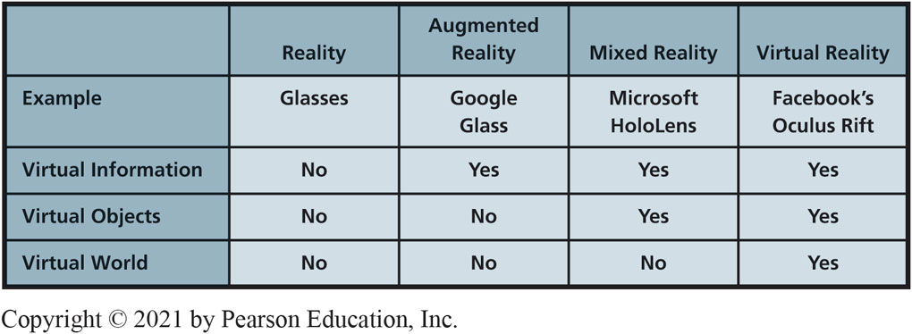
Digital Reality Devices (3 of 3)
4-2 How can new hardware affect competitive strategies?
Figure 4-7 Levels of Digital Reality

Slide 17
Self-Driving Cars by 2021
4-2 How can new hardware affect competitive strategies?
Make things easier, cheaper, safer.
Automobile accidents may become a thing of the past.
Car insurance eliminated (?).
Eliminate need to have multiple cars.
Avoid costly traffic tickets, parking tickets, D U I citations.
Figure 4-9 Future Cars Will Drive Themselves
Source: Dan Race/Shutterstock

Slide 18
Self-Driving Cars Will Disrupt Businesses
4-2 How can new hardware affect competitive strategies?
Auto sales—Fewer cars on road may mean fewer cars sold.
Also fewer auto loans, fewer auto insurance policies, and fewer collision repair shops.
More jobs for engineers, programmers, systems designers.
More computer hardware, sensors, and cameras in vehicles.
Notes:
How will self-driving cars disrupt your personal life? Eliminate pizza delivery jobs?

Slide 19
New from C E S 2019
So What?
LG Signature OLED TV R—A Roll-up TV
A 65-inch 4K TV rolls up out of a silver box that doubles as a sound bar.
A super-thin, super-light TV that comes rolled up in a smallish rectangle.
Harley-Davidson LiveWire—An all-electric motorcycle
No noise, 0 to 60 mph in 3.5 secs, 200 mile range
Jabra Elite noise-cancelling headphones
Uses AI to monitor the environment and adjust automatically
Notes:
Have students brainstorm:
1. What trends do you see pushing innovation in televisions? Why are these important to consumers?
2. Will Harley-Davidson try to market LiveWire to traditional motorcycle riders or to a new market segment? What attributes of new electric motorcycles might be less attractive to traditional motorcycle riders?
3. How might other traditional products, other than headphones, benefit from an integrated AI?
4. How can traditional companies manage the change from traditional products to IoT devices (Internet connected) and then to AI-powered devices?
5. How might the effectiveness of the AI determine the overall success of the product?
6. What security or privacy concerns might be associated with AI-powered smart devices?

Slide 20
3D Printing
4-2 How can new hardware affect competitive strategies?
Plastics, metals, wood, ceramics, foods, biological material.
Opportunities in aerospace, defense, automotive, entertainment, and healthcare industries.
What happens when 3D print extra-large objects like cars, airplanes, boats, houses, drones, etc. becomes possible?
Figure 4-10 3D Printer
Source: Seraficus/Getty Images

Slide 21
Existing 3D Printing Examples
4-2 How can new hardware affect competitive strategies?
Nike Flyprint Running Shoes
World-record setting marathon runner Eliud Kipchoge competes in 3D printed shoes custom designed by Nike

Slide 22
Cryptocurrencies
4-2 How can new hardware affect competitive strategies?
Digital-only currencies (like Bitcoin)
Use cryptographic protections to manage and record secure transactions
Benefits: faster, easier, few to no fees
Governments can’t monitor, tax, seize
Risks: price volatility, not accepted everywhere, bad reputation (organized crime(?))
Future: Blockchain—underlying technology, making all types of transactions more secure
Notes:
How will self-driving cars disrupt your personal life? Eliminate pizza delivery jobs?

Slide 23
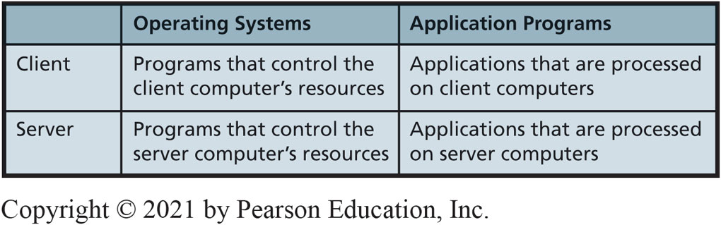
Categories of Computer Software
4-3 What do business professionals need to know about software?
Figure 4-11 Categories of Computer Software
Notes:
You need to know about functions of operating systems, servers, and applications. What are your choices? Which to choose?
Native applications
Thin-client vs thick-client applications
Web applications

Slide 24
Major Operating Systems (1 of 2)
4-3 What do business professionals need to know about software?
Figure 4-12 Major Operating Systems (continues on next slide)
Category | Operating System | Used for | Remarks
 | Windows | Personal computer clients | Most widely used operating system in business. Current version is Windows 10. Includes a touch interface.
 | mac O S | Macintosh clients | First used by graphic artists and others in arts community; now used more widely. First desktop O S to provide a touch interface. Current version is the mac O S Mojave.
Nonmobile Clients | Unix | Workstation clients | Popular on powerful client computers used in engineering, computer-assisted design, architecture. Difficult for the nontechnical user. Almost never used by business clients.
 | Linux | Just about anything | Open source variant of Unix. Adapted to almost every type of computing device. On a P C, used with Libre Office application software. Rarely used by business clients.
Notes:
Some version of Windows resides on more than 88% of world’s desktops. For business users, it's more than 95%.

Slide 25
Major Operating Systems (2 of 2)
4-3 What do business professionals need to know about software?
Figure 4-12 Major Operating Systems (con’t.)
Category | Operating System | Used for | Remarks
Mobile Clients | iO S | i Phone, i Pod Touch, iPad | Rapidly increasing installed base with success of the iPhone and iPad. Based on mac O S.
 | Android | Samsung, Google, H T C, and Sony smartphones and tablets | Linux-based phone/tablet operating system from Google. Rapidly increasing market share.
 | Windows 10 (mobile) | Nokia and Microsoft Surface | Windows 10 tailored specifically for mobile devices. Full Windows 10 on Surface Pro.
 | Windows Server | Servers | Businesses with a strong commitment to Microsoft.
Servers | Unix | Servers | Fading from use. Replaced by Linux.
Servers | Linux | Servers | Very popular. Aggressively pushed by I B M.

Slide 26
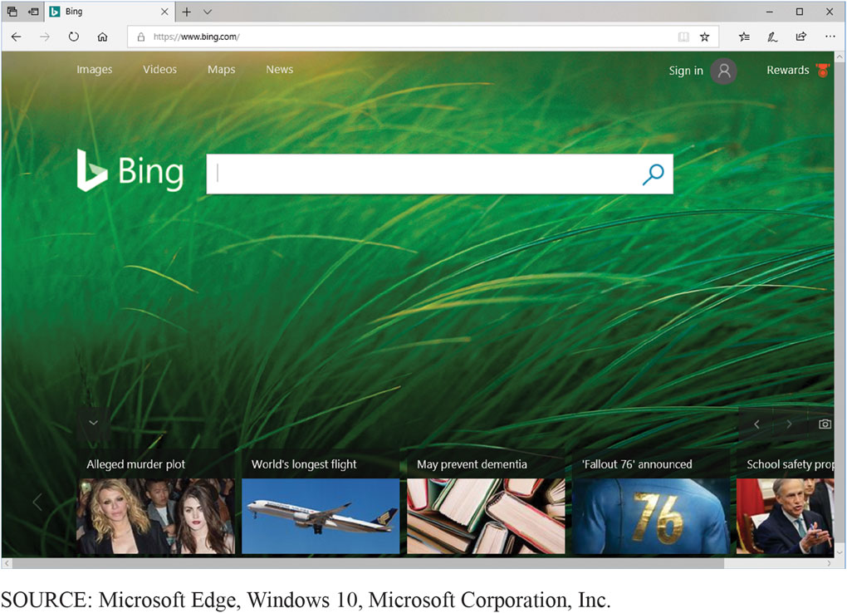
Example of the Modern-Style Interface
4-3 What do business professionals need to know about software?
Figure 4-13 Example of the Modern-Style Interface
Notes:
Windows 8 is distinguished by what modern-style applications that are touch-screen oriented and provide context-sensitive, pop-up menus used with a mouse and keyboard.

Slide 27
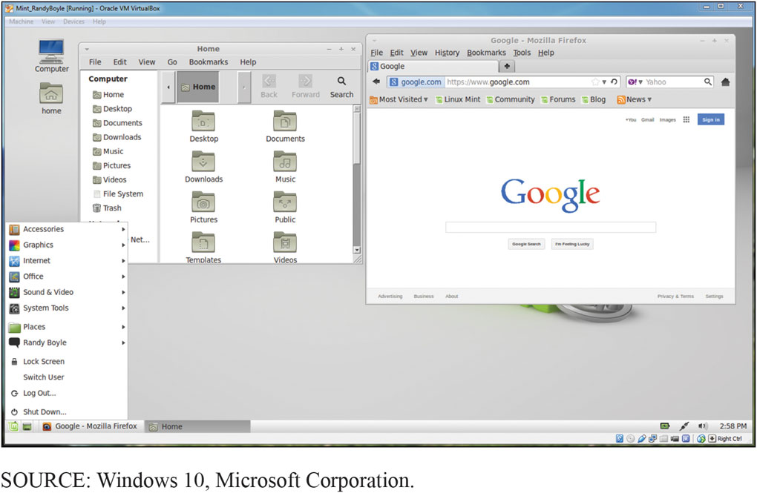
Personal Computer Hosting Two Virtual Machines (Linux and Windows)
4-3 What do business professionals need to know about software?
Figure 4-14 Linux Mint Virtual Machine Running in Microsoft Windows
Notes:
Virtualization: process by which one computer hosts the appearance of many computers. One operating system, called the host operating system runs one or more operating systems as applications. Hosted operating systems are called virtual machines (vm).
Each virtual machine has disk space and other resources allocated to it. Operates as if installed on own computer.
Host operating system controls activities of virtual machines to prevent them from interfering with one another.

Slide 28
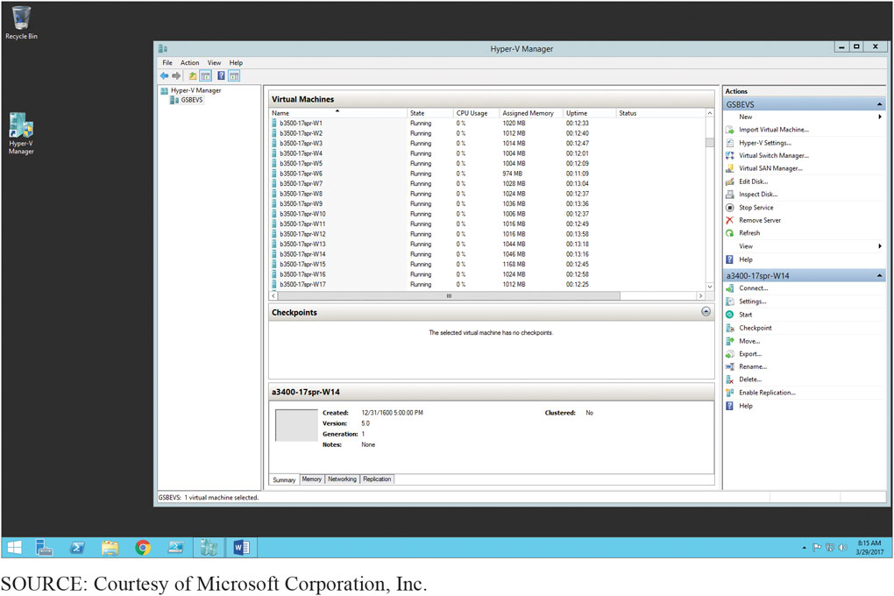
Server Virtual Machine Example
4-3 What do business professionals need to know about software?
Figure 4-15 Windows Server Computer Hosting Virtual Machines

Slide 29
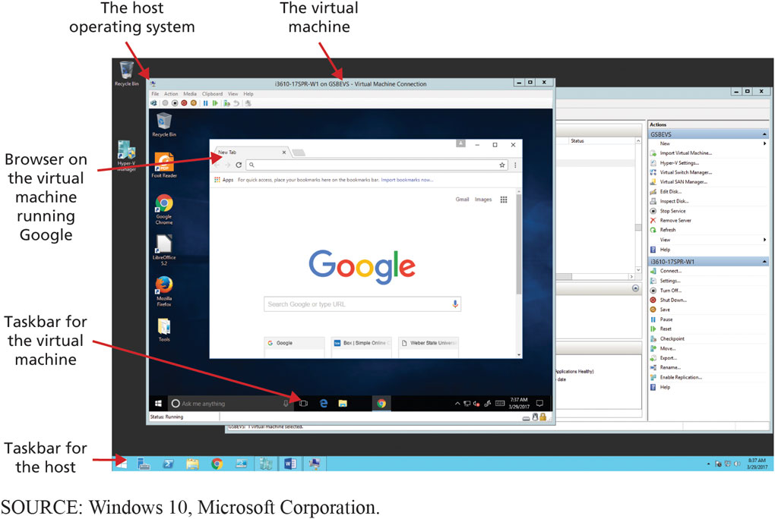
How a Virtual Machine Looks to its User
4-3 What do business professionals need to know about software?
Figure 4-16 Virtual Machine Example
Notes:
Browser on virtual machine open to Google search page.

Slide 30
Own Versus License
4-3 What do business professionals need to know about software?
“Buying software” means you buy a License.
Right to use specified number of copies.
Limits vendor’s liability.
Site License.
Flat fee to install software product on all company computers or all computers at specific site.
Open source.
No license fee.
Notes:
You do not actually own a program—you own a license or right to use the program.
When you buy a Windows license, Microsoft is selling you the right to use Windows. Microsoft continues to own the Windows program.
Large organizations negotiate a site license that authorizes the company to install the product on all company computers or a specific site.
Linux, no company can sell you a license to use it. It is owned by the open source community.

Slide 31
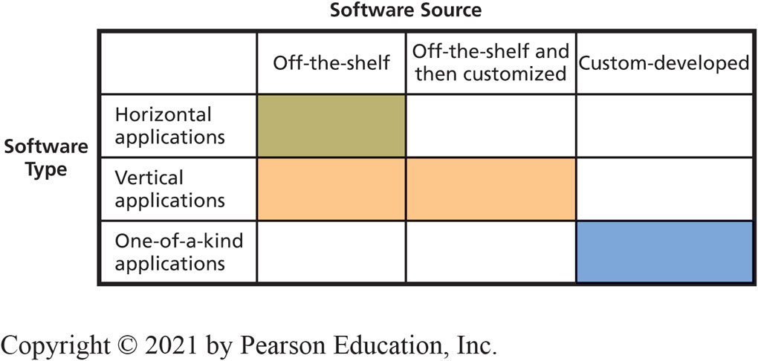
What Types of Applications Exist, and How Do Organizations Obtain Them?
4-3 What do business professionals need to know about software?
Figure 4-17 Software Sources and Types
Notes:
Horizontal-market application software provides capabilities common across all organizations and industries. Word processors, graphics programs, spreadsheets, and presentation programs are all horizontal-market application software.
Vertical-market application software serves the needs of a specific industry. Example of such programs are those used by dental offices to schedule appointments and bill patients.
One-of-a-kind application software is developed for a specific, unique need.
Because of the risk and expense, custom development is the last-choice alternative, used only when there is no other option.

Slide 32
What is Firmware?
4-3 What do business professionals need to know about software?
Special software installed on read-only memory (R O M).
Printers, print servers, communication devices.
As if program’s logic is designed into device’s circuitry.
Can be changed and upgraded like other software, but normally a task for I S professionals.
Notes:
See for more information. https://simple.wikipedia.org/wiki/Firmware

Slide 33
Examples of Open Source Software
4-4 Is open source software a viable alternative?
LibreOffice (default office suite in Linux distributions)
Firefox (a browser)
My S Q L (a D B M S, see Chapter 5)
Apache (a Web server, see Chapter 6)
Ubuntu (a Windows-like desktop operating system)
Android (a mobile-device operating system)
Cassandra (a N o S Q L D B M S, see Chapter 5)
Hadoop (a BigData processing system, see Chapter 3)
Notes:
These are examples of successful open-source projects.

Slide 34
Why Do Programmers Volunteer Their Services to Open Source Projects?
4-4 Is open source software a viable alternative?
Exercise creativity on interesting & fulfilling projects.
Freedom to choose projects.
Exhibit skills to get a job.
Start a business selling services.
Succeeds because of collaboration.
Notes:
Programming is an intense combination of art and logic. Designing and writing a complicated computer program is exceedingly pleasurable (and addictive).
Programmers can exercise creativity while working on projects they find interesting and fulfilling.
Programmers can exhibit their skill, both for pride, finding a job or consulting employment, or start a business selling services to support an open source product.

Slide 35


How Does Open Source Work?
4-4 Is open source software a viable alternative?
Closed-source or proprietary software
Only available to trusted employees and carefully vetted contractors
Open-source software
available to public
Source code: Human readable computer code
Machine code: Source code compiled into instructions executed directly by computer’s C P U
Notes:
Collaboration of many programmers
Examining source code and identifying a need, creates new feature or redesigns existing feature, or fix a problem
Code evaluated and extended by others
Iteration, peer reviews and well-managed project yield high-quality code

Slide 36
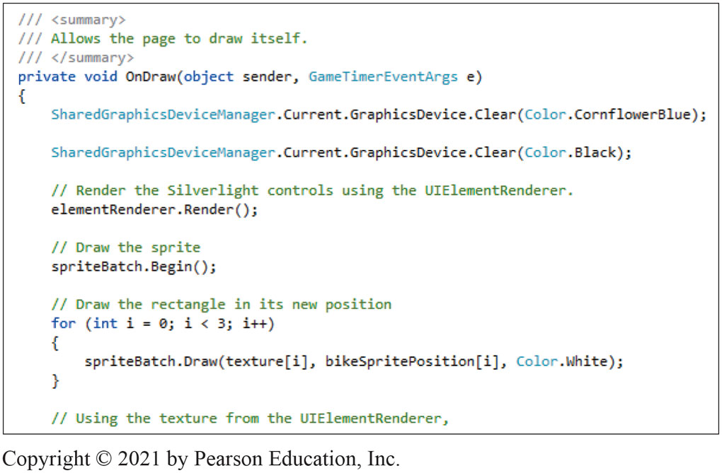
Source Code Sample
4-4 Is open source software a viable alternative?
Figure 4-18 Source Code Sample
Notes:
Figure 4-18 shows a portion of the object-oriented computer code written for the ARES project.

Slide 37
So, Is Open Source Viable?
4-4 Is open source software a viable alternative?
Depends on requirements and constraints.
“Free” open source software might require support and operational costs exceeding cost of licensing fee.
Blending proprietary and open source software in future.
Closed source project.
Highly protected source code, only available to trusted employees and carefully vetted contractors.
Notes:
Depends on requirements and constraints of situation. You will learn more about matching requirements and programs in Chapter 12.

Slide 38
How Does the Knowledge in This Chapter Help You?
Understand your involvement with technology in commerce
You learned about hardware and software
Gained knowledge of application software sources
Learned about open source software and why not always viable option
Learned hardware/software knowledge is perishable

Slide 39
Ethics Guide: Free Apps for Data
Ethics Guide
How do you monetize “free” apps?
“If you’re not paying for it, you are the product.
Data Brokers
SnoopWall reports
Flashlight Apps
Require permission to access data about your location, network connectivity, U S B storage, install shortcuts, receive data to/from the Internet, modify your system settings, and disable your screen lock.
Notes:
Goals
Sensitize students to their security exposure.
Ask the class these questions.
Why would your flashlight need your GPS coordinates? Who was getting this data? What were they using it for? It looks like someone had already thought of your data-harvesting idea.
Apply Kant’s categorical imperative and utilitarian perspectives to work Google should do about flashlight apps available on Google.

Slide 40
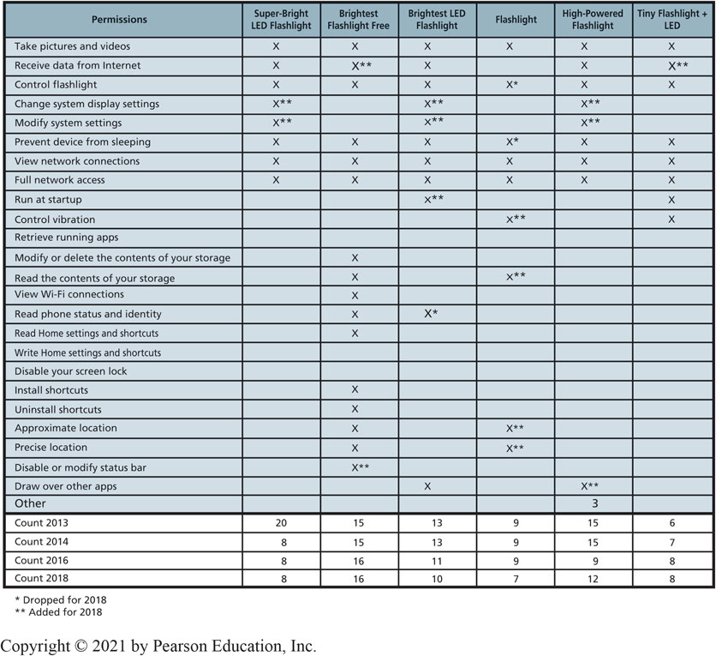
Free Apps for Data
Ethics Guide
Notes:
The bottom three rows show the changes in the number of permissions from 2013, 2014, 2016, and 2018.
Seeing all of the permissions required by simple flashlight apps is distressing. Why would your flashlight need your GPS coordinates? Who was getting this data? What were they using it for? It looks like someone had already thought of your data-harvesting idea. It may be too late to make any money off the free-app-for-individual-data scheme. All of a sudden, these free apps don’t look as attractive to you—as a consumer.

Slide 41
Senior Software Engineer
Career Guide
Marshall Pettit at Preparis, Inc.
Q. What attracted you to this field?
A. “Web software development has always fascinated me since taking an elective during my undergraduate business management studies. Building complex yet elegant business systems using commands in a text editor is as fulfilling as building a home from raw materials and seeing it take shape.”
Q. What advice would you give to someone who is considering working in your field?
A. “Just do it. Take a leap of faith and run with the challenges ahead. Courageously tackling your dream job in spite of the imaginary barriers around it will be both fun and rewarding.”

Slide 42
Active Review
4-1 What do business professionals need to know about computer hardware?
4-2 How can new hardware affect competitive strategies?
4-3 What do business professionals need to know about software?
4-4 Is open source software a viable alternative?

Slide 43
The Apple of Your i (1 of 2)
Case Study 4
Created mobile markets with i Pod, i Phone, i Pad.
Opened own stores.
Open and inviting sales floor, Genius Bar help desk, incredibly well-trained and disciplined sales force.
Pioneered Internet sale of music and applications.
Sixth largest public company in world.
Notes:
List of world’s biggest public companies. http://www.forbes.com/global2000/list/#tab:overall

Slide 44
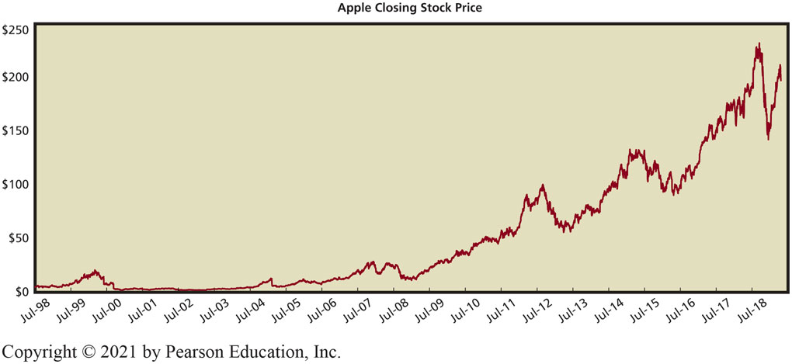
The Apple of Your i (2 of 2)
Case Study 4
Figure 4-19 Growth in Apple Stock Price

Slide 45

Copyright

